Slide 1



Machine learning
What it is, how it works, and why we use it

Slide 2

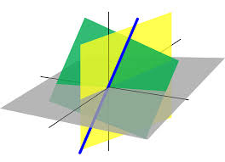
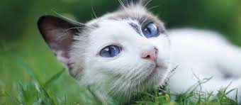
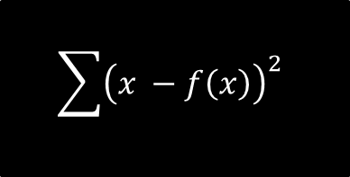
What is machine learning?
$$\sum{{\left(x −f\left(x\right)\right)}^{2}}$$
DATA
FANCY MATH
MAKE A PREDICTION!
Cat!

Slide 3
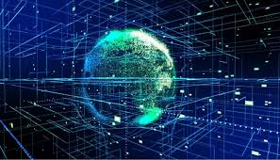
Why we use machine learning
Find patterns humans can’t and don’t notice
Big data
Computer vision
Natural Language processing
(NLP)

Slide 4
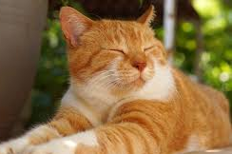
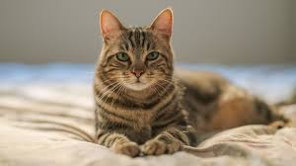
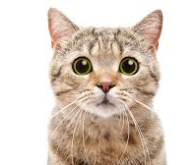
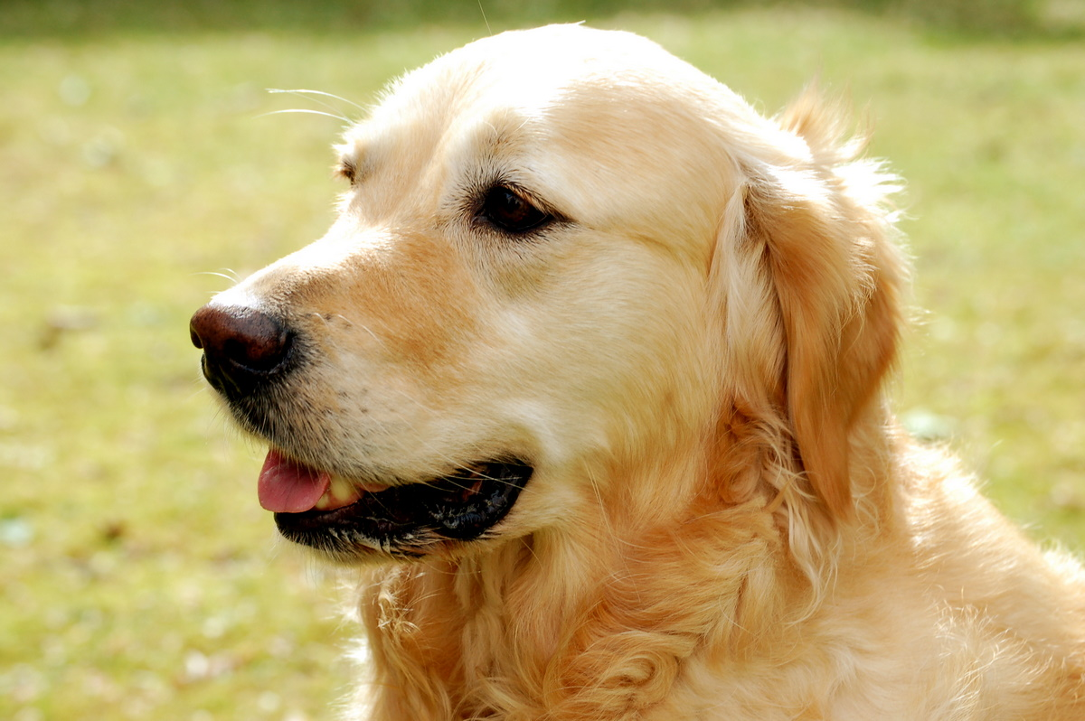
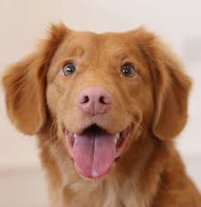
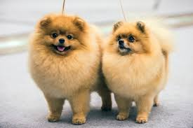
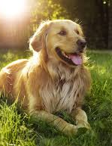
How we use machine learning
Labeled Data:
Cats & Dogs
Train the model
Test the model
Dog
The model says I’m a dog
teachablemachine.withgoogle.com/models/MhR0yhfrV/
This model actually works!
Click on link!
Cat
This Photo by Unknown Author is licensed under CC BY-SA

Slide 5
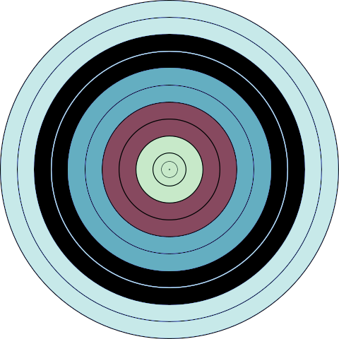
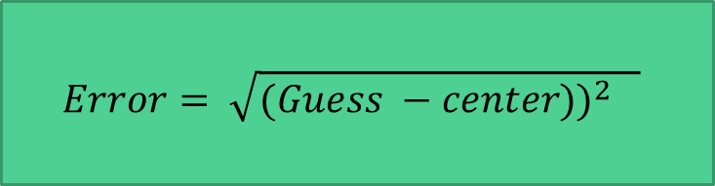
Supervised Machine learning (simplified)
Update guess
(Make a slightly better guess)
(2) Figure out how bad that guess was
$$Error= \sqrt{{(Guess −center))}^{2} }$$
(1) Make a random guess

Slide 6
Supervised Machine learning (simplified)
Initialize your model
(1) Make a random guess

Slide 7
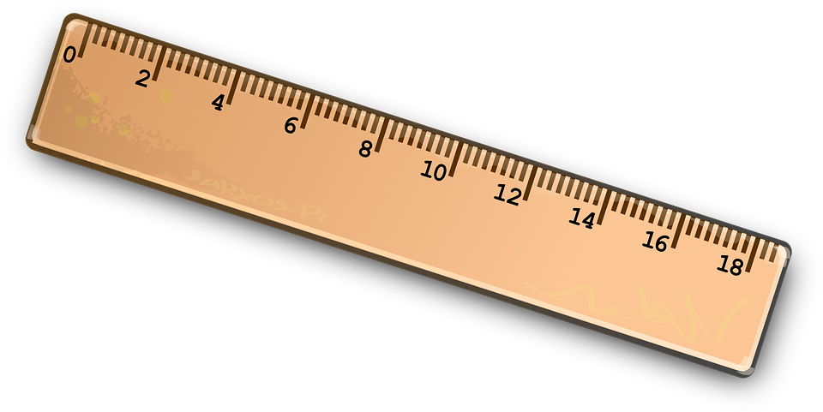
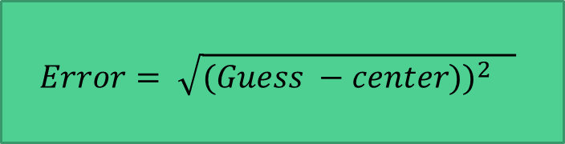
Supervised Machine learning (simplified)
(2) Measure the distance from guess to target
Calculate the error using a cost function
$$Error= \sqrt{{(Guess −center))}^{2} }$$

Slide 8

Supervised Machine learning (simplified)
Update guess
Also called the learning rate or step size
Small steps, learning rate must be small

Slide 9
Supervised Machine learning (simplified)
REPEAT lots of times
Until cost is as small as possible
Update guess
Also called the learning rate or step size

Slide 10
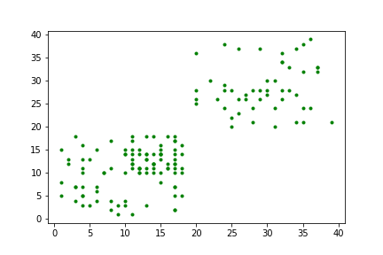
K-means algorithm
Analyzing data from a roof, they discove

Slide 11
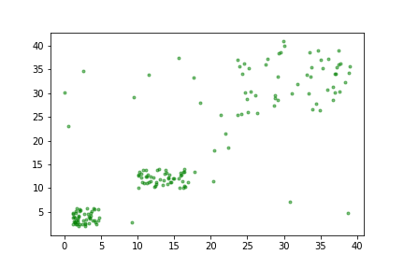
K-means algorithm
Where are the targets most likely located?
How many targets do you think we have?

Slide 12
Our algorithm
Make a guess on number of targets
Initialize random target values
Calculate error
Repeat

Slide 13
Our algorithm
To-do
Decide number of kernels to test
Decide learning rate
Calculate number of repeats

Slide 14
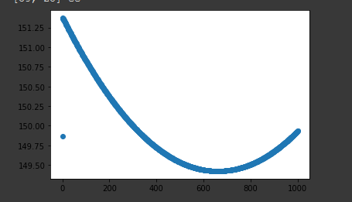
Analysis
Our code will generate these graphs
This is loss versus iteration
Minimum loss

Slide 15
Explore!
These next few slides will show you how to run the code environment
You will get to play around with different hyperparameters such as learning rate, iterations, number of centroids.
On a separate piece of paper record your findings!

Slide 16
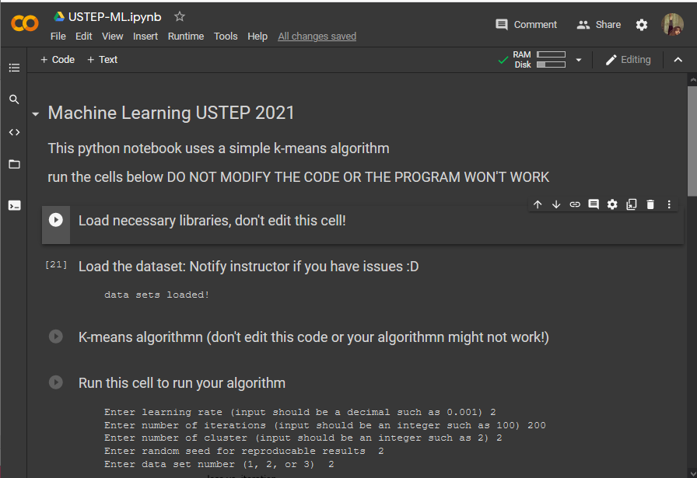
No coding is necessary

Slide 17
Run these cells
Click on the arrow
These load the needed code

Slide 18
Run these cells
Click on the arrow
Click on this run bottom to run your algorithm

Slide 19
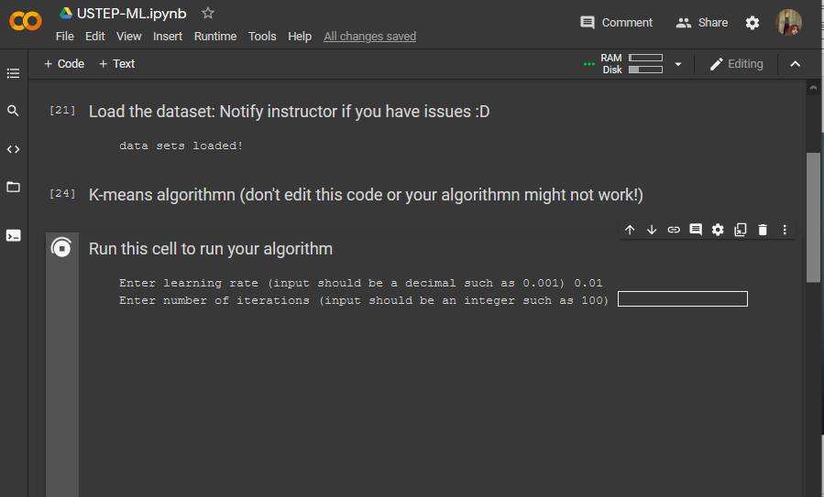
After you run you will be prompted to to enter your learning rate etc….

Slide 20

Explore more! Other machine learning models
Another k-means algorithm
https://user.ceng.metu.edu.tr/~akifakkus/courses/ceng574/k-means/
Image model used earlier in the slides
https://experiments.withgoogle.com/collection/ai

